Slide 1
Public Sentiment on Social Media in Response to Receiving a Covid Vaccine
Noah Sheldon

Slide 2
Motivations
Covid Pandemic
Availability of Social Media Data
Advances in Natural Language Processing(NLP)

Slide 3
Project objectives
Collection of Twitter data using tweepy API.
Visualization of the collected data.
Pre-processing the collected data.
Performing topic modelling on pre-processed data.
Visualizing the results of topic modelling.
Performing classification of the data.

Slide 4
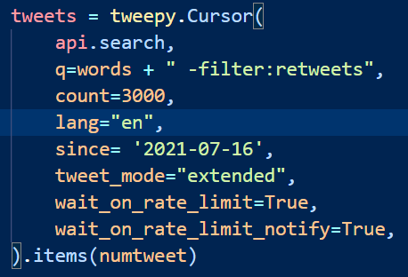
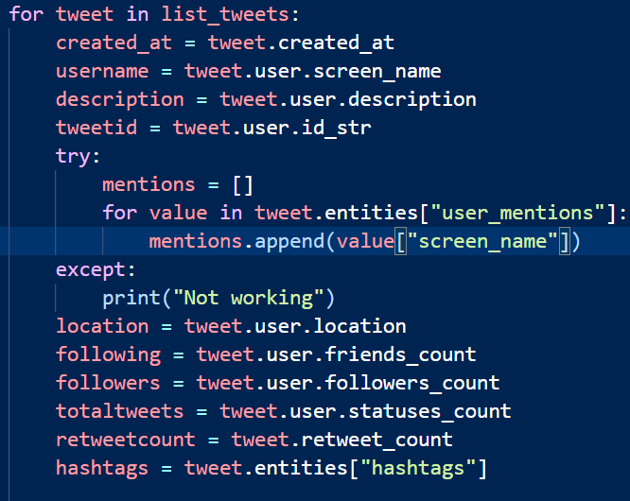
Data collection
Using tweepy API
Storing Twitter Data

Slide 5
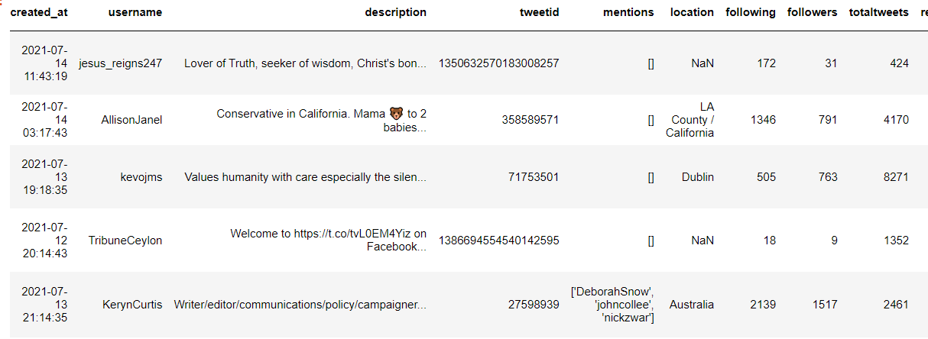
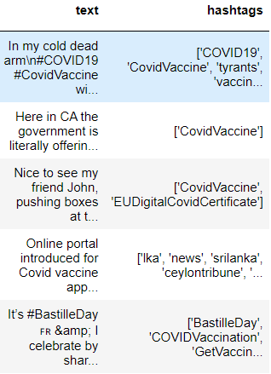
Data Dictionary/ Data frame

Slide 6
Data pre-processing
Removing links, hashtags, and mentions
Tokenization
Removing stop words
Lemmatization

